Slide 1
Economical Principles
Business

Slide 2
Economical principles
Principle of Productivity
Principle of Economy
Principle of Profitability

Slide 3
Productivity
Relationship between production ((trading) and invested effort.
Production (trading)
Productivity=---------------------------------------
Invested effort

Slide 5
Economy
Relationship between production (trading) and expenses.
Production (trading)
Economy=---------------------------------------
Expenses

Slide 7
Profitability
Relationship between profit and invested means (consistent and rotatory)
Profit
Profitability=---------------------------------------
Invested means

Slide 9
Effectiveness
Effectiveness means capacity of company to provide necessary resources and use them more effectively to fulfill its target.
Effectiveness means doing the right work.

Slide 10
Efficiency
Efficiency is relationship between the results of the functioning of the company and the investments that are necessary to fulfill the same/
Efficiency means doing the job in a right way.

Slide 11
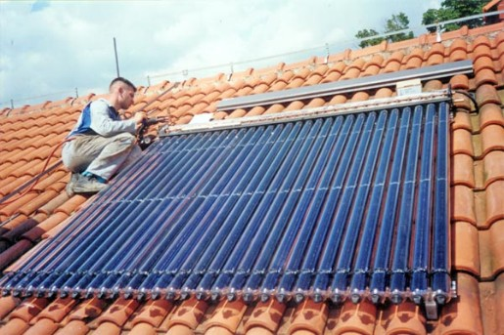
Efficiency is measured by the relation of consumed means of work and production.

Slide 12
Productivity (task)
Bakery “n” produces daily 180.000 pieces of bread, producing cost of 6000 hours labour. Calculate the productivity of the bakery expressed with the amount of produced bread per hour.
Q = 180.000 pieces of bread
T = 6.000 h labour
P=?
P = Q/T=180.000,00/6000h =30 par/h -30 pieces of bread are produced per hour
Normal working time per hour( needed hours for production work for a piece of bread)
T_{h}=T/Q
T_{h}=6.000/180.000 pieces
T_{h}=0,03 h зa 1 piece of bread.For production of one piece of bread are needed 0,003 hors or 2 minutes.

Slide 13
Economy (task)
Company of tile production, has produced 4.000.000,00 tiles.For that reason it has spent 1,200000 kg material .500000 hours work time with machines and 200000 hours work force.
Calculate partial economy of the company
Е=value/Expenses =V/T
Е_{material}=4.000.000/1.200.000=3,33 pieces/kg
Е_{work} toolsf=4.000.000/500.000=8 pieces/hour
Е_{work} force =4.000.000/200.000=20 pieces/hour

Slide 14
Profitability (task)
TaskЗ: The company in 2009 has gained profit in the amount of 300.000 denars, with committed funds of с900.000 denars. In 2010 it gained profit in the amount of 250.000 denars, with committed funds of с 1.000.000 denars.
Calculate the level and dynamics of profitabilityа с.
2009
R₁=profit/Committed funds=300.000/900.000=0,33
2010
R₂=profit/committed funds=250.000/1.000.000=0,25
i_{r}= R₂/ R₁·100%=0,25/0,33 =75,76% reduction

